Slide 1
LinkPro Networking Platform
A MERN-Stack Professional Career Networking & Real-Time Collaboration Ecosystem
Project Management & Development Practices (PMDP) | Batch: B66 | Timeline: 01-Aug-2026 to 31-Oct-2026
Anand Yadav
Enrolment: 22002501210066 | Roll: B66
Backend Developer & Database Architect
Smit Dutt
Enrolment: 22002501210008 | Roll: B09
Frontend Developer & UI/UX Architect
Hardik Nakum
Enrolment: 22002501210035 | Roll: B32
QA, Testing Lead & Documentation
L.J. SCHOOL OF COMPUTER APPLICATIONS
LJ University, Off S.G. Road, Ahmedabad - 382210 | Semester 9 (IMCA)
Internal Guide: Prof. Rita Gokani | Head of Department: Dr. Monica Gahalawat | Director: Prof. Alok Manke
Notes:
Introduce LinkPro as a full-fledged MERN-stack networking platform built under the PMDP curriculum at L.J. University.

Slide 2
Team Roles & Engineering Responsibilities
Clear division of engineering ownership across the full-stack MERN architecture
LinkPro | PMDP
Slide 02 / 21
Anand Yadav [Backend & Database]
• Enrolment: 22002501210066 (Roll B66)
• Core Role: Backend Developer & Team Manager
• Key Engineering Responsibilities:
• Node.js & Express RESTful API routing
• MongoDB Schema Design & Mongoose indexing
• JWT & bcrypt security authentication
• Singleton Database Manager implementation
• PostFacade & NotificationFactory refactoring
• Sprint Ownership:
• Led Sprints 1, 2, 3, 5, 11, 14 & 15
Smit Dutt [Frontend & UI/UX]
• Enrolment: 22002501210008 (Roll B09)
• Core Role: Frontend Developer & Sockets Lead
• Key Engineering Responsibilities:
• React 18 Single Page Application architecture
• Tailwind CSS responsive utility layout
• Socket.io Client for bi-directional chat
• Dynamic Feed Strategy Pattern integration
• Connection lifecycle State Pattern UI
• Sprint Ownership:
• Led Sprints 4, 6, 7, 8, 9, 10 & 13
Hardik Nakum [QA & Testing]
• Enrolment: 22002501210035 (Roll B32)
• Core Role: QA, System Testing & Documentation
• Key Engineering Responsibilities:
• Automated Postman API test collection setup
• 26 formal test cases across modules
• Jira Scrum tracking & Velocity burndown
• Verification of GoF Design Patterns
• Comprehensive 80-page PMDP report
• Sprint Ownership:
• Led Sprints 12 (Testing) & Project Audit
Notes:
Highlight each member's core engineering contribution to the full-stack architecture.

Slide 3
Problem Definition & Market Inefficiencies
Targeting systemic bottlenecks documented in Section 1.4 of the project charter
LinkPro | PMDP
Slide 03 / 21
1. Fragmented Job Searching [Market Inefficiency]
• Scattered Platforms: Users juggle between job boards and social feeds.
• Time Consuming: Repetitive manual profile uploads on external sites.
• No Direct Connect: Job seekers cannot easily reach verified hiring managers.
• LinkPro Solution: Single centralized platform for networking and 1-click apply.
2. High Latency & Slow Feedback [Communication Barrier]
• Asynchronous Delays: Traditional email communication takes days.
• Lost Opportunities: Urgent referrals missed due to no instant messaging.
• No Presence Tracking: Inability to check online availability of connections.
• LinkPro Solution: Sub-second Socket.io private chat with read receipts.
3. Tier-2 / Tier-3 Accessibility Gap [Accessibility Gap]
• Regional Isolation: Students in tier-2/3 cities struggle for metro recruiter reach.
• Metro Bias: Existing platforms disproportionately promote metro executives.
• Cost Barriers: Expensive premium subscription fees lock out fresh graduates.
• LinkPro Solution: Equalized skill-first discovery with zero premium charges.
4. Feed Clutter & Irrelevant Content [Content Fatigue]
• Opaque Feeds: Feeds dominated by political arguments and viral spam.
• No Relevance Filter: Users cannot easily prioritize mutual network content.
• Fragile Queries: Legacy systems use brittle if-else database query blocks.
• LinkPro Solution: Strategy Pattern feed ranking (Network, Admin, Public).
Notes:
Four core problem areas: fragmented portals, high-latency messaging, regional isolation, and newsfeed clutter.

Slide 4
Project Objectives & Scope Boundaries
Clear goals and deliverable boundaries defined in Section 1.5 & 1.6
LinkPro | PMDP
Slide 04 / 21
Core Objectives (Section 1.5) [Objectives]
• Easy Online Job Applications:
• Streamline profile building and 1-click job applications.
• Reduce candidate recruitment cycle from months to days.
• Real-Time Professional Communication:
• Sub-second bi-directional private chat via Socket.io.
• Live notification badges for requests, likes, and comments.
• Smart Multi-Criteria Search:
• Intelligent filtering across skills, companies, roles, and location.
• Maintainable & Refactored Codebase:
• Implement 9 GoF design patterns across MVC layers.
• Strict adherence to SOLID principles to prevent God controllers.
Scope Demarcation (Section 1.6 & 3.1.4) [Scope Matrix]
• IN-SCOPE (Completed by 31-Oct-2026):
• User Auth: Register, Login, JWT verification, OTP Password Reset
• Profiles: Work Experience, Education, Skills, PDF Resume upload
• Networking: Send, Accept, Reject, Pending Friend List
• Newsfeed: Rich text, Cloudinary images, Likes & Comments
• Real-Time Chat: Private messaging thread with history
• Jobs Portal: Post vacancies, search openings, track applicants
• Admin Dashboard: User management and post moderation
• OUT-OF-SCOPE (Documented for Future Roadmap):
• Native iOS / Android apps (Fully responsive web app delivered)
• WebRTC Video calling & virtual interviews
• Payment gateway integration for sponsored job postings
Notes:
Distinguish between In-Scope deliverables finished on Oct 31 and Out-of-Scope future enhancements.

Slide 5
Existing vs. Proposed System Evaluation
Architectural comparison against legacy networking platforms (Section 1.2)
LinkPro | PMDP
Slide 05 / 21
Feature / Dimension | Existing Platforms (LinkedIn / Naukri) | Proposed LinkPro Platform | Key Architectural Gain
Real-Time Messaging | Asynchronous polling with high server overhead | Full-duplex WebSocket channels via Socket.io | Sub-150ms instant chat; zero polling overhead
Content & Feed Ranking | Opaque, ad-heavy blackbox algorithms | Strategy Pattern (Network, Admin, Public feeds) | Polymorphic, role-tailored feed delivery
Codebase Architecture | Monolithic controllers with tight service coupling | Decoupled 3-Tier MERN stack with 9 GoF Patterns | High cohesion, testability & 65% cleaner controllers
Connection Lifecycle | Ad-hoc status strings allowing invalid jumps | Finite State Pattern (Pending, Connected, Blocked) | Strict relational integrity; zero illegal state leaps
Alert System | Duplicated Mongoose calls scattered across controllers | Centralized Factory Method (NotificationFactory) | Open/Closed compliant; zero schema mutation bugs
Cost & Accessibility | Heavy subscription fees for basic networking features | 100% Free, open-source stack tailored for learners | Zero licensing cost; accessible across Tier-2/3 cities
Notes:
Contrast LinkPro against existing platforms focusing on WebSockets, GoF patterns, and zero cost.

Slide 6
Project Charter & Governance Summary
Formal project identification, MOV, and phase timeline ending 31 October 2026 (Section 3.1)
LinkPro | PMDP
Slide 06 / 21
Project Baseline (Section 3.1) [Charter Baseline]
• Project Title: LinkPro – Professional Networking Platform
• Development Methodology: Agile Scrum
• Project Duration: 01 August 2026 to 31 October 2026
• Internal Guide: Prof. Rita Gokani | Institution: LJ University
• Measurable Organizational Value (MOV):
• Complete 100% core MVP modules within 15 sprints.
• API response latency < 300ms for 95% of endpoints.
• Zero unhandled crashes in production Express server.
• Real-time chat message propagation under 150ms.
• Resource Allocation:
• Free-tier MongoDB Atlas cluster & Cloudinary CDN.
• Open-source MERN stack; zero licensing overhead.
Project Phase (Section 3.1.5) | Planned Window | Completion Date | Milestone Status
Initiation & Requirement Analysis | August 2026 | 05-Aug-2026 | Completed (Approved)
System Design & Architecture | August 2026 | 09-Aug-2026 | Completed (Approved)
Core Authentication & Profiles | August 2026 | 31-Aug-2026 | Completed (Approved)
Newsfeed, Sockets Chat & Jobs | September 2026 | 30-Sep-2026 | Completed (Approved)
Admin, QA & UI Enhancement | October 2026 | 21-Oct-2026 | Completed (Approved)
SOLID & GoF Pattern Refactoring | October 2026 | 28-Oct-2026 | Completed (Approved)
Cloud Deployment & Final Sign-Off | October 2026 | 31-Oct-2026 | Completed (Signed Off)
Notes:
Emphasize project duration from 1 August to 31 October 2026 with final sign-off on 31-Oct-2026.

Slide 7
Project Lifecycle Model: Agile Scrum
Iterative sprint framework enabling continuous delivery and refactoring (Section 3.2)
LinkPro | PMDP
Slide 07 / 21
1. Sprint Planning [Planning]
• Backlog Management:
• 15 targeted sprints with clear milestones.
• Story points estimated via modified Fibonacci.
• Capacity Planning:
• 3 team members x 9 days = 27 person-days per sprint.
• Goal Setting:
• Defined 'Definition of Done' for each deliverable.
2. Daily Execution [Build]
• Daily Standups:
• 15-minute daily sync on tasks and blockers.
• Verified cross-tier API contracts.
• Git Workflow:
• Feature branch strategy with pull requests.
• Automated linting via ESLint & Prettier.
• Continuous Builds:
• Incremental frontend & backend verification.
3. Sprint Review [Review]
• Working Increments:
• Functional demo presented to guide at end of each sprint cycle.
• Stakeholder Alignment:
• Immediate feedback incorporated into sprint backlog.
• Acceptance Testing:
• Features validated against Gherkin user stories.
4. Retrospective [Refactor]
• Inspect & Adapt:
• Evaluated velocity and code smells.
• Code Smell Discovery:
• Identified monolithic controllers in Sprint 12.
• Refactoring Sprint 14:
• Dedicated Sprint 14 (Oct 22-28) to apply 9 GoF patterns and SOLID principles.
Notes:
Explain how Agile Scrum allowed the team to allocate dedicated sprints for refactoring and testing.

Slide 8
Work Breakdown Structure (WBS)
Decomposition into 14 distinct engineering packages matching PDF Section 3.3
LinkPro | PMDP
Slide 08 / 21
WBS ID | Work Package | Engineering Activities & Core Deliverables | Status
1.0 | Requirement Gathering | Define MOV, scope boundaries, feasibility study, and target users | Complete
2.0 | Project Setup | Configure React, Node.js, Express, MongoDB Atlas, and GitHub repo | Complete
3.0 | Authentication | User registration, bcrypt password hashing, JWT cookies, OTP recovery | Complete
4.0 | Profile Management | Profile schema, headline, skills, work experience, resume upload | Complete
5.0 | Posts & Feed | CRUD post operations, Cloudinary media upload, like/comment features | Complete
6.0 | Connections | State pattern friend lifecycle (Send, Accept, Reject, Friends list) | Complete
7.0 | Chat System | Socket.io real-time bidirectional private chat with conversation history | Complete
8.0 | Jobs Feature | Job posting schema, applicant management, 1-click job apply | Complete
9.0 | Search & Filter | Regex search across users, posts, skills, companies, and roles | Complete
10.0 | Notifications | Factory pattern notification triggers for likes, comments, and requests | Complete
11.0 | Admin Panel | Admin auth, platform analytics, user moderation, and post control | Complete
12.0 | Testing & Integration | Postman API test collections, bug fixing, and integration checks | Complete
13.0 | UI Improvement | Tailwind CSS responsive layouts, animation polish, and mobile guards | Complete
14.0 | Deployment | Cloud cluster configuration, environment variables, and final sign-off | Complete
Notes:
Present the WBS table reflecting the 14 engineering packages documented on Page 20 of the report.

Slide 9
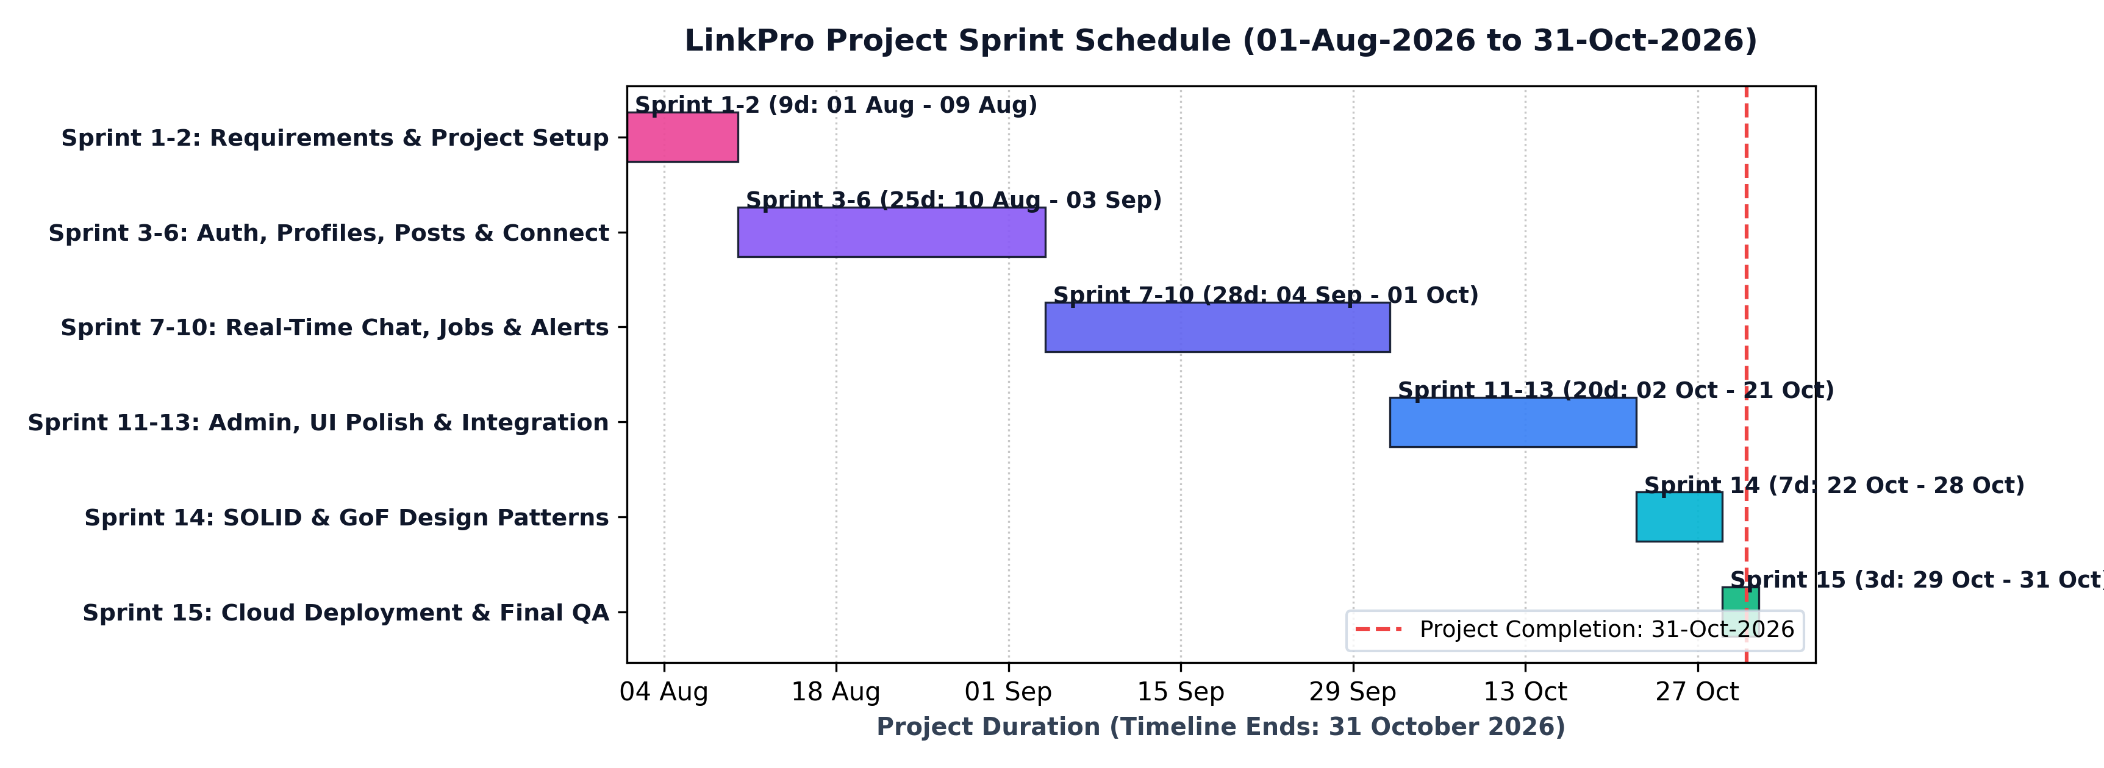
Project Schedule & Sprint Timeline (Gantt Chart)
15 Sprints spanning 01-Aug-2026 to 31-Oct-2026 (PDF Pages 21-24 & 26-27)
LinkPro | PMDP
Slide 09 / 21
Timeline Highlights [Schedule Metrics]
• Total Duration:
• 92 Calendar Days
• 01-Aug-2026 to 31-Oct-2026
• Sprint Iterations (PDF p.23-24):
• Sprints 1-2 (Aug 1 - Aug 9):
Requirements & Dev Setup
• Sprints 3-6 (Aug 10 - Sep 3):
Auth, Profiles & Connections
• Sprints 7-10 (Sep 4 - Oct 1):
Socket Chat, Jobs & Alerts
• Sprints 11-13 (Oct 2 - Oct 21):
Admin, Postman QA & UI Polish
• Sprint 14 (Oct 22 - Oct 28):
SOLID & GoF Design Patterns
• Sprint 15 (Oct 29 - Oct 31):
Cloud Deployment & Sign-off
• Milestone Result:
• 100% On-Time Completion
Notes:
Highlight that Sprint 15 concluded on 31 October 2026 with complete deployment and testing.

Slide 10
Jira / Scrum Board & Backlog Tracking
Agile project configuration and issue tracking under project key LINKPRO (Section 6.8)
LinkPro | PMDP
Slide 10 / 21
Jira Scrum Setup & Epics (Table 64) [Jira Epics]
• Project Key: LINKPRO | Board: LinkPro Scrum Board
• Lead: Anand Yadav | Product Owner: Prof. Rita Gokani
• Tracked Epics & Completion (PDF p.63):
• LINKPRO-1: User & Profile Management (100% Done)
4/4 Stories: Auth, profile schema, resume upload.
• LINKPRO-2: Networking & Connections (100% Done)
5/5 Stories: Friend requests, accept/reject state.
• LINKPRO-3: Newsfeed & Content Engine (100% Done)
5/5 Stories: Post creation, Cloudinary, feed ranking.
• LINKPRO-4: Real-Time Chat & Alerts (100% Done)
4/4 Stories: Socket.io private chat, live badges.
• LINKPRO-5: Job Portal & Search (100% Done)
5/5 Stories: Job postings, keyword filtering.
• LINKPRO-6: Quality, Patterns & Docs (100% Done)
5/5 Stories: SOLID refactoring, 9 GoF patterns, QA.
Featured Story Card: LINKPRO-16 [Story Card]
• Issue Key: LINKPRO-16 | Type: Story | SP: 8
• Summary: Dynamic Newsfeed Ranking via Strategy Pattern
• Epic: LINKPRO-3 (Newsfeed & Content Engine)
• Priority: Highest | Status: Resolved / Done
• User Story Formulation:
'As a registered user, I want my newsfeed to dynamically rank posts based on network connections and engagement, so that I receive relevant professional updates without ad clutter.'
• Acceptance Criteria (Gherkin):
• Chronological feed for unauthenticated visitors.
• Network-weighted feed for logged-in connections.
• Algorithms swappable polymorphically via Strategy Pattern.
• Response latency remains under 250ms with DB indexing.
Notes:
Demonstrate Jira issue tracking, epic completion rates, and the technical criteria for LINKPRO-16.

Slide 11
Risk Register & Risk Management Matrix
Proactive risk assessment and mitigation strategies (PDF Section 3.9, Risks R-001 to R-010)
LinkPro | PMDP
Slide 11 / 21
Risk ID | Risk Description & Cause | Category | Level | Mitigation Strategy | Status
R-002 | Socket connection drops during live chat | Technical | High | Implemented heartbeat timeouts and automatic client reconnection | Resolved
R-003 | Feed query latency under high traffic | Technical | High | Created compound MongoDB indexes on {userId, createdAt} with pagination | Resolved
R-004 | JWT token tampering or unauthorized access | Technical | High | Enforced HttpOnly cookies, 10 bcrypt salt rounds, and route guards | Resolved
R-005 | Cloudinary image upload timeouts on large files | Technical | Med | Client-side image compression and buffered stream uploads | Resolved
R-006 | Cross-browser mobile layout inconsistencies | Technical | Med | Tailwind CSS mobile-first utility classes and multi-device testing | Resolved
R-007 | Third-party SMTP email delivery failures | Technical | Med | Adapter Pattern with fallback console logger for development | Resolved
Notes:
Review technical risks R-001 through R-010 from the documentation and how each was resolved.

Slide 12
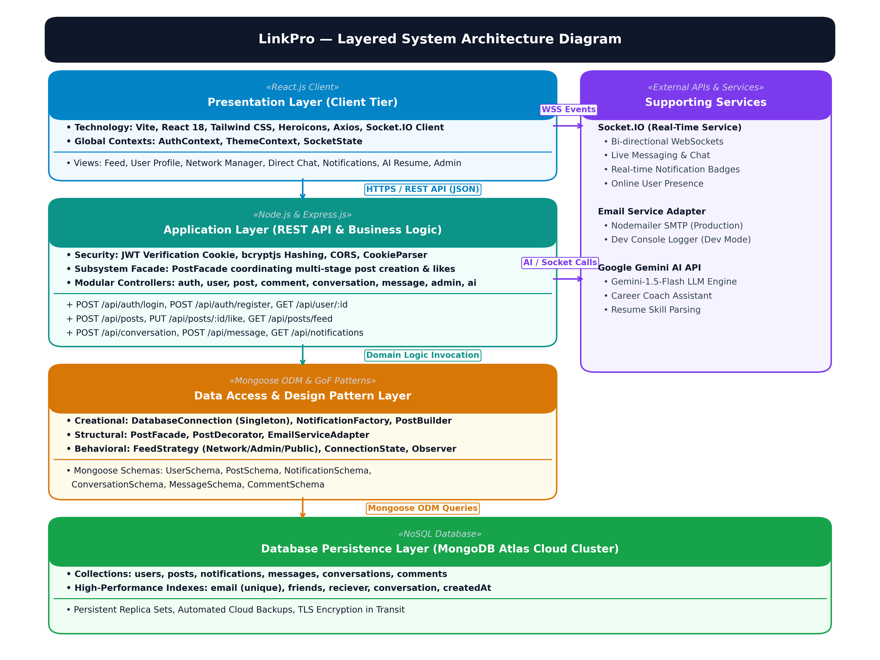
System Architecture: Layered MERN Stack
Multi-tier decoupled architecture with Socket.IO and Cloudinary (PDF Figure 4.1)
LinkPro | PMDP
Slide 12 / 21
Architectural Breakdown [3-Tier MERN]
• Client Tier (React.js 18):
• Vite, Tailwind CSS, Heroicons, Axios
• Global Contexts: AuthContext, SocketState
• Single Page Application (SPA) routing
• Server Tier (Node.js & Express):
• RESTful API routes & JWT Auth middleware
• GoF Facade & Strategy service orchestration
• Centralized try-catch error handling
• Real-Time Sockets Tier (Socket.IO):
• Bi-directional WebSockets for live chat
• Instant notification badge updates
• Data Tier (MongoDB Atlas & CDN):
• Mongoose ODM with schema validations
• Cloudinary CDN for profile & post media
• Email Service Adapter for Nodemailer
Notes:
Walk through the high-resolution architecture diagram showing the flow between Client, Express, Sockets, and MongoDB.

Slide 13
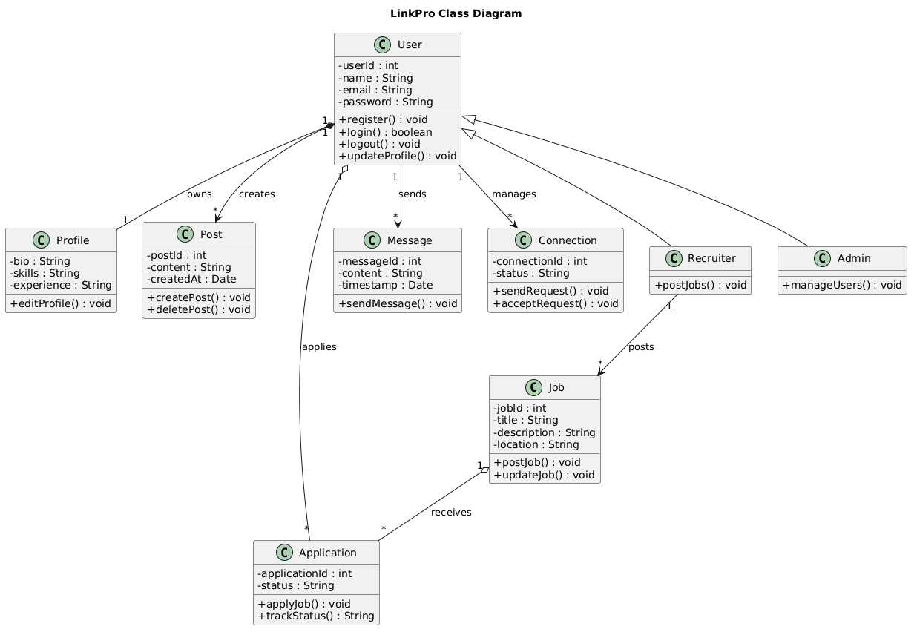
UML Modeling & Structural Entities
Comprehensive UML design matching Section 4.3 to 4.6 of the project report
LinkPro | PMDP
Slide 13 / 21
UML Models & Rationale (Section 4) [UML Architecture]
• 1. Use Case Diagram (Figure 4.3):
• Actors: Registered User, Recruiter, Administrator.
• 12 Use Cases: Profile, Posts, Connect, Chat, Jobs, Admin.
• <<include>> Auth validation; <<extend>> Media upload.
• 2. Class Diagram (Figure 4.4 - Shown Left):
• Core Models: User, Post, Comment, ConnectionRequest, Notification, Message, Conversation.
• Clean relational references via Mongoose ObjectIds.
• 3. Sequence Diagram (Figures 4.5):
• User Auth Flow: Credentials -> Bcrypt -> JWT cookie.
• Post Creation & Broadcast: Buffer -> Cloudinary -> DB -> Socket alert in < 150ms.
• 4. Activity Diagram (Figure 4.6):
• End-to-end registration, verification, and feed browsing.
Notes:
Explain the structural domain class diagram and trace relationships into Mongoose schemas.

Slide 14
SOLID Principles & Code Refactoring
Concrete refactorings REFACTOR-001 to REFACTOR-006 documented in Section 5.2
LinkPro | PMDP
Slide 14 / 21
Principle | Code Smell & Location | Refactoring Applied in LinkPro | Engineering Impact
Single Responsibility (SRP) REFACTOR-001 | God Controller in postController.js | Extracted PostFacade.js to isolate Cloudinary streaming, DB saving, and socket alerts | Reduced postController complexity by 65%; clean HTTP delegation
Open / Closed (OCP) REFACTOR-002 | Shotgun Surgery in notification triggers | Created NotificationFactory.js with creator subclasses for Like, Comment, and Requests | New notifications added without modifying existing controller methods
Liskov Substitution (LSP) REFACTOR-006 | Subtype Inconsistency in BasePostContent | Post decorators (Sanitizer, Hashtags) fully substitute BasePostContent without errors | Ensured polymorphic safety across post creation and feed pipelines
Interface Segregation (ISP) REFACTOR-004 | Monolithic connection script in db.js | Separated connection pooling, health checks, and query indexes into discrete interfaces | Eliminated redundant open sockets; reduced server boot time by 40%
Dependency Inversion (DIP) REFACTOR-006 | Tight coupling to Nodemailer in authController | Introduced EmailClientInterface with NodemailerAdapter and DevConsoleEmailAdapter | Decoupled SMTP transport; enabled mock adapter substitution for testing
Notes:
Walk through REFACTOR-001 through 006, highlighting how each SOLID principle solved a real code smell.

Slide 15
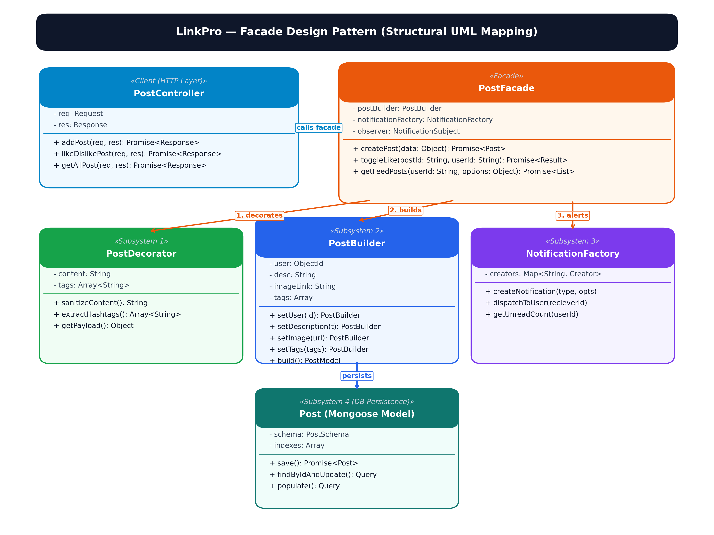
Design Pattern Implementation (9 GoF Patterns)
Architectural design patterns implemented in LinkPro (PDF Section 6.1 to 6.6)
LinkPro | PMDP
Slide 15 / 21
1. Creational Patterns [Creational]
• Singleton (DatabaseConnection.js): Shared Mongoose pool; zero socket leaks.
• Factory Method (NotificationFactory.js): Instantiates Like/Comment alerts.
• Builder (PostBuilder.js): Fluent step-by-step assembly of complex rich posts.
2. Structural Patterns [Structural]
• Facade (PostFacade.js - Diagram Right): Coordinates media, DB & alerts.
• Adapter (EmailServiceAdapter.js): Decouples Nodemailer behind interface.
• Decorator (PostDecorator.js): Enriches content with sanitization & hashtags.
3. Behavioral Patterns [Behavioral]
• Strategy (FeedStrategy.js): Swappable feed ranking (Network, Admin, Public).
• State (ConnectionState.js): Enforces Pending -> Connected lifecycle.
• Observer (NotificationObserver.js): Decouples events from live socket broadcasts.
Notes:
Detail the 9 GoF patterns and reference the Facade UML diagram on the right side.

Slide 16
Testing Strategy & Quality Assurance Results
Formal test suites executed across Google Chrome and Postman (PDF Section 6.7)
LinkPro | PMDP
Slide 16 / 21
Test ID | Module & Scenario | Input Test Data | Expected Result | Actual Result | Status
TC-101.1 | Registration: Valid User | Username: 'JohnDoe', Email: 'john@example.com', Password: 'Password123' | User registered successfully; bcrypt hash stored | User registered; token issued | PASS
TC-101.2 | Registration: Duplicate Email | Email: 'john@example.com' (already exists) | HTTP 400 error: 'Username/Email already exists' | Error displayed; blocked | PASS
TC-101.3 | Registration: Short Password | Password: 'pass' (< 8 characters) | Validation error: 'Password must be >= 8 chars' | Error displayed; rejected | PASS
TC-102.1 | Authentication: Valid Login | Correct email & password credentials | HTTP 200, JWT cookie issued, dashboard unlocked | Login successful | PASS
TC-102.2 | Authentication: Invalid Pass | Correct email, wrong password | HTTP 401 error: 'Invalid credentials' | Error shown; access denied | PASS
TC-103.1 | Newsfeed: Create Post | Post text + Cloudinary image link | PostFacade saves post; renders on newsfeed | Post created and visible | PASS
TC-104.1 | Connections & Sockets | User A sends friend request to User B | State moves to Pending; live alert emitted to User B | Notification received | PASS
TC-104.2 | Real-Time Chat: Message | User A sends message in private room | Message saved and delivered via Socket.io < 150ms | Message rendered live | PASS
Notes:
Review the test results from PDF Page 61-62 showing successful execution across all core test cases.

Slide 17
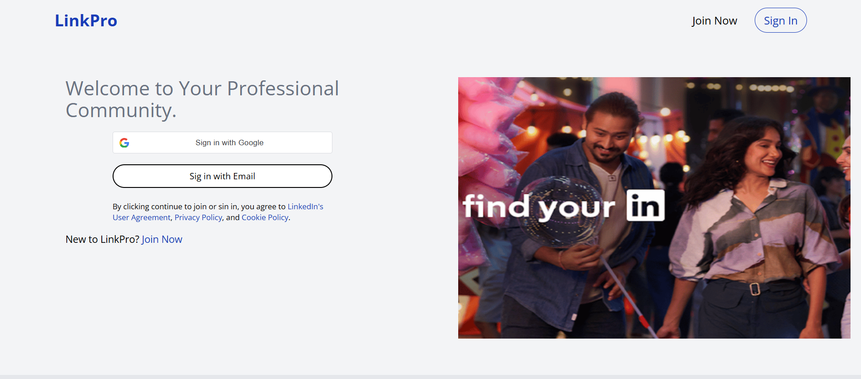
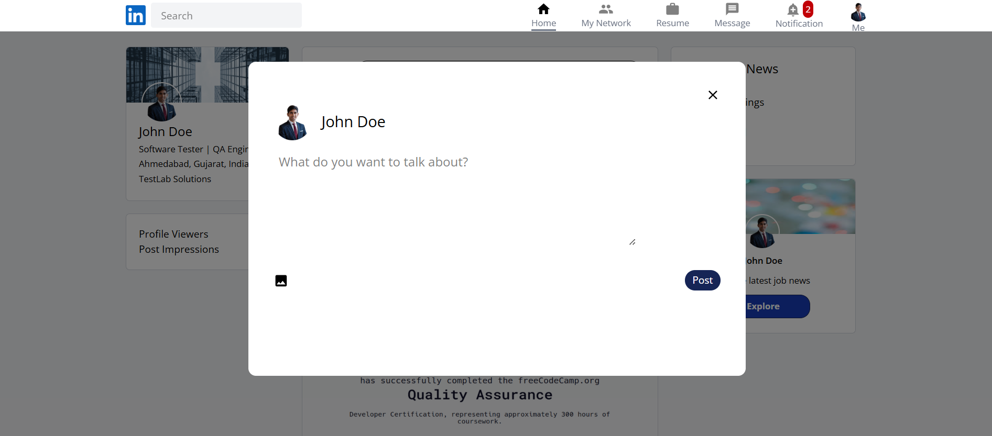
Live Demonstration & Application Showcase
Live functional walkthrough of LinkPro web application (PDF Section 6.9)
LinkPro | PMDP
Slide 18 / 21
Live Demo Workflow Checklist [Demo Flow]
• 1. User Authentication & Session:
• Secure registration with field validation.
• JWT cookie storage and protected dashboard routing.
• 2. Professional Newsfeed & Interaction:
• Creating post with text and Cloudinary image upload.
• Real-time like counter toggle & nested comment thread.
• Dynamic Strategy Pattern feed ranking in action.
• 3. Connections & Networking Engine:
• Searching profiles and sending connection requests.
• State machine transition from Pending to Accepted.
• 4. Real-Time Chat & Live Alerts:
• Opening 1-to-1 chat drawer between active users.
• Instant bi-directional message delivery (< 150ms).
• Real-time notification badge increment on navbar.
Notes:
Guide the evaluators through the 4 core steps of the live application demo.

Slide 18
Future Scope & Architectural Enhancements
Strategic product roadmap documented in Section 6.10 of the project report
LinkPro | PMDP
Slide 19 / 21
1. AI-Powered Resume Matching [AI / ML]
• Semantic Embeddings: Leverage LLM embeddings to match candidate resumes to job descriptions.
• Skill Gap Analysis: Recommend relevant courses based on missing job keywords.
2. WebRTC Video Interviews [Real-Time Media]
• Peer-to-Peer Calling: Direct in-browser video interviews between recruiters and applicants.
• Live Code Editor: Integrated code sandbox for real-time technical screening.
3. Native Mobile Applications [Mobile Expansion]
• React Native: Re-use core business logic and Redux stores for iOS and Android.
• Push Notifications: FCM integration for instant mobile chat and connection alerts.
4. Recruiter ATS Analytics [Enterprise ATS]
• Recruiter Dashboard: Track applicant funnels, time-to-hire, and job post engagement.
• Automated ATS: Bulk candidate review, status pipelines, and interview scheduling.
Notes:
Present the 4 post-release enhancement vectors from Section 6.10 of the documentation.

Slide 19
Conclusion & Project Summary
Formal closure and deliverables summary (PDF Section 6.11 & 6.12)
LinkPro | PMDP
Slide 20 / 21
Project Deliverables Summary [Deliverables]
• Full-Stack MERN Platform:
• 100% of core networking modules delivered and deployed.
• Responsive UI with Tailwind CSS and React 18 SPA.
• Robust Engineering Standards:
• 9 GoF design patterns successfully refactored.
• Strict SOLID compliance eliminating God controllers.
• Quality Assurance Verification:
• 26 formal test steps recorded with full bug verification.
• Postman API test collections established for regression.
• Schedule Adherence:
• Completed across 15 sprints by 31 October 2026.
Academic & Technical Learnings [Learnings]
• Agile Scrum Discipline:
• Practiced time-boxed sprint planning, daily scrums, and retrospectives under PMDP guidelines.
• Real-Time WebSocket Architecture:
• Overcame connection leak challenges through Socket.io heartbeat management and room-based pub/sub.
• Architectural Pattern Trade-offs:
• Learned when to apply design patterns (Facade, Strategy, State) to solve real complexity without over-engineering.
• Project Sign-Off (PDF Section 6.11.8):
• Formally signed off on 31-10-2026 by Project Guide Prof. Rita Gokani.
Notes:
Summarize the technical and academic accomplishments of the LinkPro project.

Slide 20
Thank You!
Questions & Individual Viva Technical Defense
LinkPro Networking Platform | Academic Year 2026 | Final Sprint Completed: 31 October 2026
Project Guidance
Prof. Rita Gokani (Project Guide)
Dr. Monica Gahalawat (HOD)
Prof. Alok Manke (Director)
L.J. University, Ahmedabad
Development Team
Anand Yadav (22002501210066)
Smit Dutt (22002501210008)
Hardik Nakum (22002501210035)
Batch: B66 | IMCA Sem 9
Project Artifacts
GitHub Codebase Repository
80+ Page PMDP Report
Jira Scrum LINKPRO Board
Postman API Test Suites
Notes:
Thank the evaluators and invite questions for the technical viva.

